Slide 1
Interactive Multi-Grained Joint Model for Targeted Sentiment Analysis
Advisor: Jia-Ling Koh
Presenter: Cheng-Wei Chen
Source: CIKM’19
Data: 2020/12/1

Slide 2
Outline
Introduction
Method
Experiments(with conclusion)

Slide 3
Outline
Introduction
Target
Previous work
Change in this paper

Slide 4
Target
Give a sentence x =[x1, x2, ..., xn], xi ∈ R^{dw}, we want to do targeted sentiment analysis and get two tagging sequences:
y^{T}=[y^{T}₁ , y^{T}₂ , ..., y^{T}_{n} ] for target extraction
y^{S} = [y^{S}₁ , y^{S}₂ , ..., y^{S}_{n} ] for target-based sentiment classification.
The number of target extraction labels and sentiment classification labels are C_{tar} and C_{sen}
Ex: Feel so sad about Whitney Houston. (as above)
Use BIO scheme(Labeling task) with
named entity types (e.g. person and organization)
sentiment polarity types (e.g. positive, negative and neutral).

Slide 5
Previous work
Pay more attention to either target extraction or sentiment classification independently
Previous work
Pipeline method was the usual way in the past, but
Cannot fully take advantage of the mutual benefits of the two subtasks

Slide 6
New change in this paper
Joint method(Modified)
Care about relations between Target extraction and sentiment classification.
By finding which words are modified by sentiment clues, the model could extract targets more accurately.
Alleviate the overlap of two kinds of roles.(Two kinds of loss)

Slide 7
Outline
Method
Architecture
Coarse-grained
Interaction
Fine-grained
Loss function

Slide 8
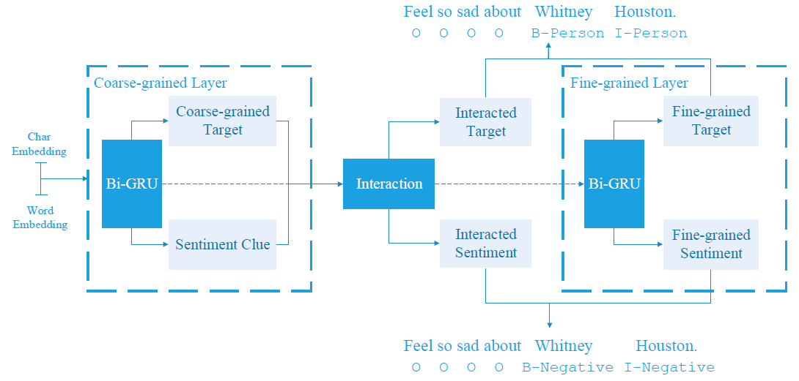
Architecture
Two layer Bi-GRU
sentence x =[x1, x2, ..., xn], xi ∈ R^{dw}
CNN
sentence ch =[ch1, ch2, ..., chn], chi ∈ R^{dch}
Concatenate two embedding and do Bi-GRU
Design an interaction mechanism to build information exchange process between target and their corresponding sentiment clues.
Find probability inferring to a part of
target and a sentiment clue

Slide 9
Architecture
Learn specific gravity & use CRF to
model the dependencies between labels
Learn specific gravity & use CRF to
model the dependencies between labels

Slide 10
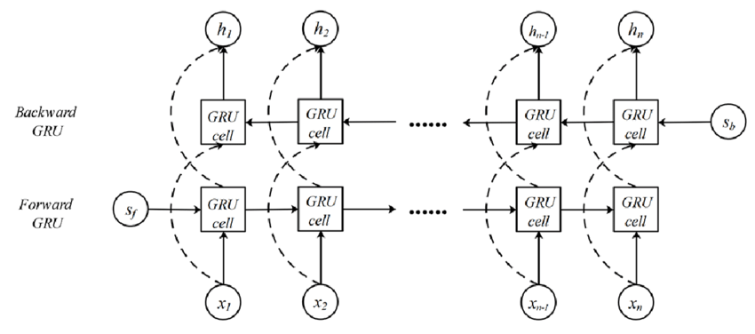
Coarse-grained
sentence x =[x1, x2, ..., xn], xi ∈ R^{dw}
sentence ch =[ch1, ch2, ..., chn], chi ∈ R^{dch}
Concatenate two embedding and do Bi-GRU=> h_{i}
d_{h} = 2(d_{w} + d_{ch})
Probability means whether a word
belongs to a target or sentiment clue or not.
Where W^{z} , W^{q} ∈ R^{2×dh} are weight matrices.

Slide 11
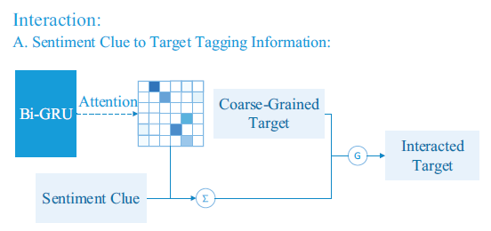
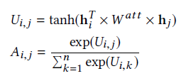
Interaction
A. Sentiment clue information to target tagging information:
(Attention Value)
Ex: If
1.‘sad’ is predicted as a sentiment clue. (high z^{S}_{j})
2.‘Houston’ is highly linked to ‘sad’. (high A_{i, j})
=>‘Houston’ has a high possibility of being a target.

Slide 12
Interaction
A. Sentiment clue information to target tagging information:
Gate mechanism
W^{g} ∈ R^{db×db} and W^{trans} ∈ R^{db×da}

Slide 13
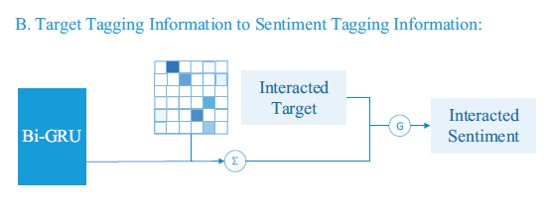
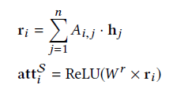
Interaction
B. Target tagging information to sentiment tagging information:
att^{S}i ∈ R^{Csen} is the attention-based
sentiment tagging information.

Slide 14
Fine-grained
h i => h i′ (Bi-GRU)
Conditional random fields

Slide 15
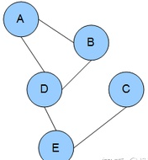
Fine-grained
(CRF)
勢函數(偏導數等於速度在那個方向的分量)
A為極大團的集合；
a為某一個極大團；

Slide 16
Loss function

Slide 17
Experiments
資料集

Slide 18
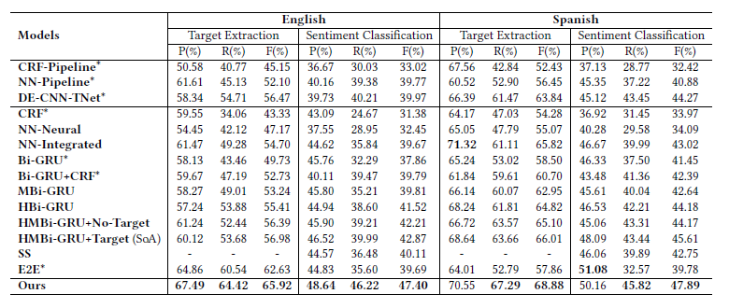
Experiments (With other method) (W/O partial work)

Slide 19
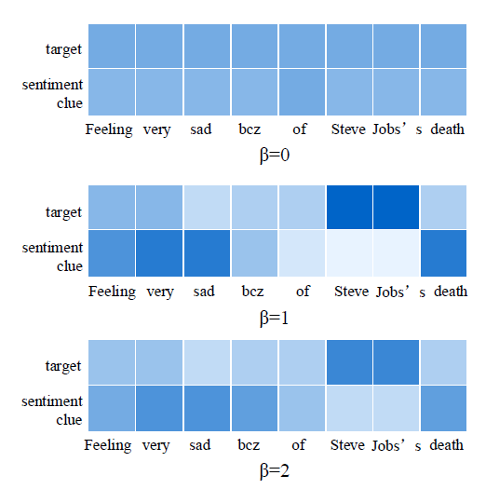
Experiments (W/O loss and different parameter)

